Slide 1

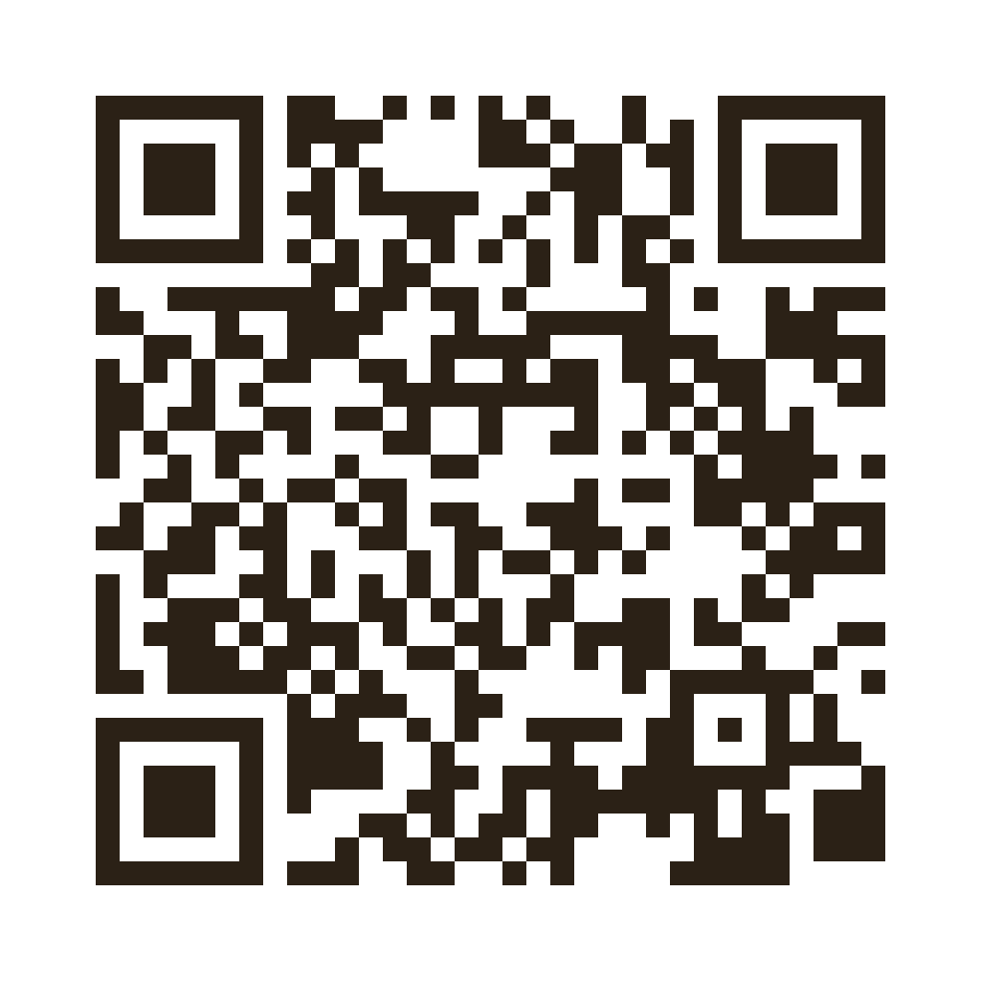
Stroke: From Door to Needle and Thrombolytic Therapy
Updated to AHA/ASA 2026 · with the European (ESO) comparison
Dr Mohamed Najm Aldeen Alameen Abdalrahman
MBBS · FEBN · PGDip EM · MRCEM (Secondary) · MSc Neurology, Buckingham (in progress)
Neurologist · Neurocritical Care & Neurological Emergencies
Khamis Mushait General Hospital · Ministry of Health, Saudi Arabia
ORCID 0009-0001-5506-2757
THE TRACT
Independent Neurology Press
thetract.org/lectures
Scan for these slides, the PDF and the 2026 updates
Notes:
Title. The QR code opens the lecture page on thetract.org (slides, PDF, sources).

Slide 2

PRE-TEST · QUESTION 1 OF 3
The dose
A 62-year-old man (80 kg) arrives 2 hours after the onset of right hemiparesis and aphasia — a disabling deficit. CT shows no haemorrhage. You choose tenecteplase. What do you give?
A 20 mg (4 mL) as a single IV bolus
B 40 mg (8 mL) as a single IV bolus
C 72 mg: 7.2 mg bolus, then 64.8 mg over 60 min
D 25 mg (5 mL) — the fixed stroke dose
Answer at the end of the lecture
Notes:
Pre-test question 1. Let the audience vote by hand before moving on. Answer: A.

Slide 3
PRE-TEST · QUESTION 2 OF 3
The clock
A 70-year-old woman was last known well 7 hours ago. NIHSS 9, disabling. CT: no haemorrhage. CTA: no large vessel occlusion. Automated CT perfusion: core 12 mL, penumbra 55 mL. Best next step?
A No reperfusion — she is beyond 4.5 hours
B IV thrombolysis
C Mechanical thrombectomy
D Repeat imaging with MRI before deciding
Answer at the end of the lecture
Notes:
Pre-test question 2. Let the audience vote by hand before moving on. Answer: B.

Slide 4
PRE-TEST · QUESTION 3 OF 3
The mild stroke
A 55-year-old man presents 90 minutes after mild numbness of the left face and arm. NIHSS 2. He walks, works and manages daily tasks normally. CT and CTA are normal. Best treatment?
A Alteplase 0.9 mg/kg
B Tenecteplase 0.25 mg/kg
C Aspirin + clopidogrel (dual antiplatelets)
D Full-dose heparin
Answer at the end of the lecture
Notes:
Pre-test question 3. Let the audience vote by hand before moving on. Answer: C.

Slide 5
Overview of Stroke
1. Global Impact
Stroke is a leading cause of death and disability worldwide, with approximately 15 million people affected annually.
2. Ischemic Strokes
Ischemic strokes account for about 87% of all strokes.
3. Time-Sensitive
The phrase 'time is brain' emphasizes the critical need for rapid assessment and treatment.
4. Early Intervention
Early intervention can significantly improve patient outcomes and reduce long-term disability.
5. Pre-Hospital Management
Stroke management starts pre-hospital.

Slide 6
What Changed in 2026
AHA/ASA 2026 guideline for acute ischaemic stroke — the first full rewrite since 2018
01
02
03
Tenecteplase = alteplase
TNK 0.25 mg/kg (max 25 mg) or alteplase 0.9 mg/kg within 4.5 h — both Class 1.
Up to 9 hours
IVT at 4.5–9 h, or ≤ 9 h from mid-sleep, if automated perfusion shows penumbra (Class 2a).
Disabling, not a number
Treat a disabling deficit at any NIHSS. Mild non-disabling → DAPT, not IVT (Class 3).
04
05
06
Thrombectomy widened
Large core (ASPECTS 3–5) and basilar occlusion with NIHSS ≥ 10, within 24 h — Class 1.
Don't over-lower BP
SBP < 140 after successful thrombectomy: Class 3, Harm. Keep < 180/105 for 24 h.
Faster systems
Mobile stroke units Class 1. Don't wait for creatinine before CTA/CTP (Class 1).
Source: Prabhakaran S, et al. Stroke 2026 · doi:10.1161/STR.0000000000000513
Notes:
Six changes to remember. Each is expanded later in the lecture.

Slide 7
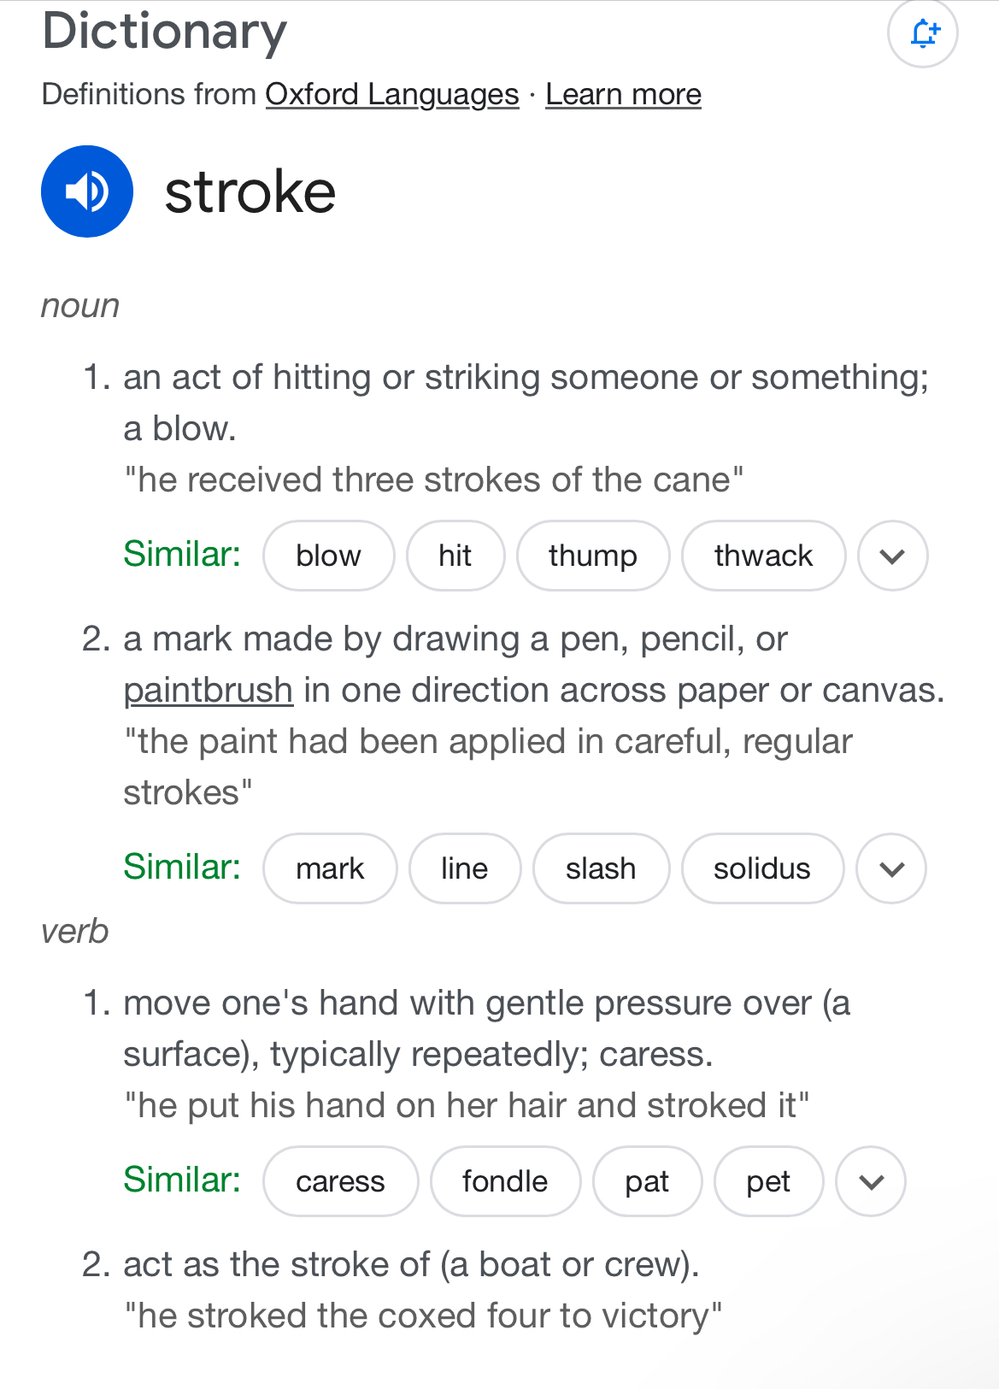
Discovering the Etymology of Stroke
The term "stroke" comes from the Middle English "strok" — "a blow", the same root as "strike". The medical sense, "a stroke of God's hand", appears in the late 1500s. This reflects the sudden nature of a stroke, often felt like being struck by something unexpected. Additionally, in the medical context, the Latin term "ictus" was used, meaning "a blow" as well, highlighting how quickly a stroke can take effect. Imagine a person, let’s say 58 years old, who experiences a stroke out of nowhere while at a family gathering—this sudden incident can leave everyone in shock. Understanding this history helps illustrate the abrupt and impactful experience of a stroke.

Slide 8
Defining Stroke According to Leading Institutions
Evidence-Based Insights from Renowned Medical Sources
What is Stroke?
Types of Stroke
A stroke occurs when blood flow to the brain is interrupted by a blockage or burst blood vessel. This can lead to brain damage and impaired bodily functions. For example, a hospital report might state that 15% of patients experience long-term complications after a stroke.
Strokes are categorized into two main types: ischemic and hemorrhagic. Ischemic strokes, caused by blockages, account for about 87% of all strokes. Hemorrhagic strokes occur when a blood vessel ruptures. Understanding these types is crucial for timely treatment.
Impact of Stroke
Stroke Risk Factors
According to the World Health Organization, strokes are a leading cause of death globally, affecting approximately 15 million people each year. Of these, nearly 5 million do not survive, highlighting the urgent need for awareness and prompt medical response.
Common risk factors include high blood pressure, diabetes, and smoking. For instance, studies show that individuals with untreated high blood pressure are three times more likely to experience a stroke. Managing these factors can significantly reduce stroke risk.

Slide 9
Role of Emergency Medical Services (EMS)
BE-FAST Acronym
EMS uses the BE-FAST acronym for early recognition of stroke symptoms: Balance abnormalities, Eyes (visual problems), Face drooping, Arm weakness, Speech difficulties, and Time to call emergency services.
Rapid Pre-Notification
Pre-notification to the receiving hospital allows for rapid stroke team activation.
Transport Protocol
2026: take the patient to the closest appropriate stroke-capable hospital. If a large vessel occlusion is suspected (e.g., RACE > 4) and a thrombectomy centre is within reach — or fast transfer is not available — go direct. Mobile stroke units are now Class 1.

Slide 10
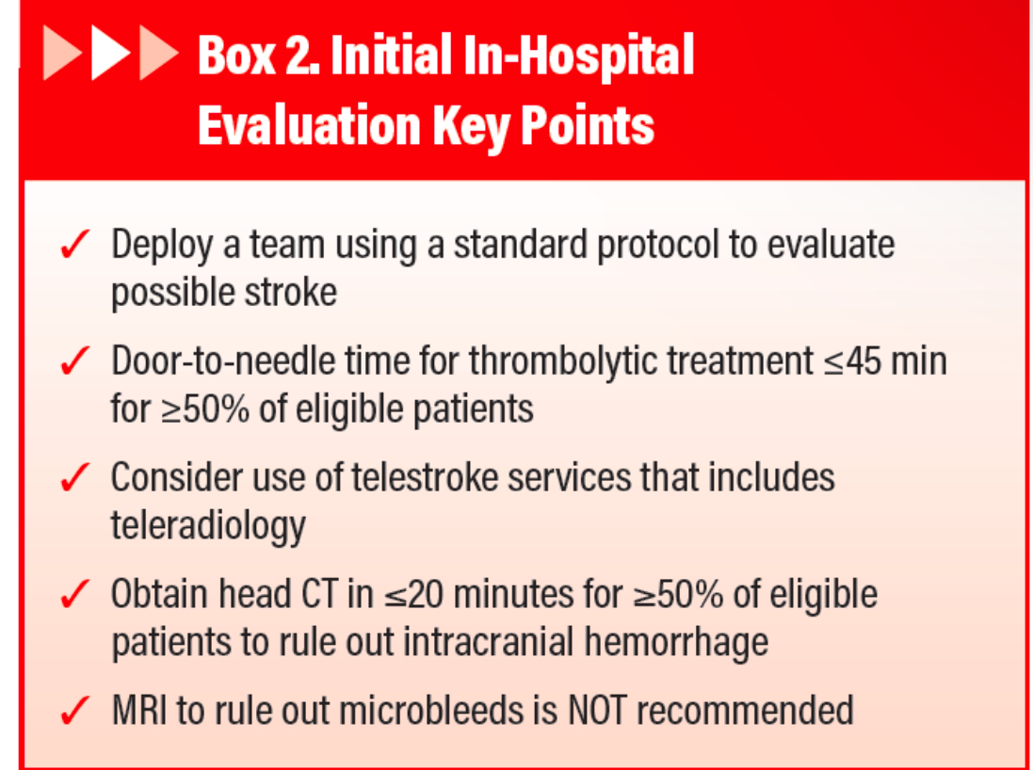
Emergency Department Care and Stroke Specialty Guidance
When a patient arrives in the emergency department with stroke symptoms, every second counts. The team should quickly activate a stroke code and prepare for a rapid evaluation. Key assessments include obtaining a history of symptoms and conducting a focused neurological examination within minutes. For example, a fictional patient showing signs of weakness might receive a NIHSS score calculated in under 10 minutes. Stroke specialists should be consulted early to guide treatment decisions and ensure the latest protocols are followed. For instance, specialists may recommend a CT scan and quick thrombolytic therapy if the patient meets the criteria, aiming to improve recovery chances significantly.

Slide 11
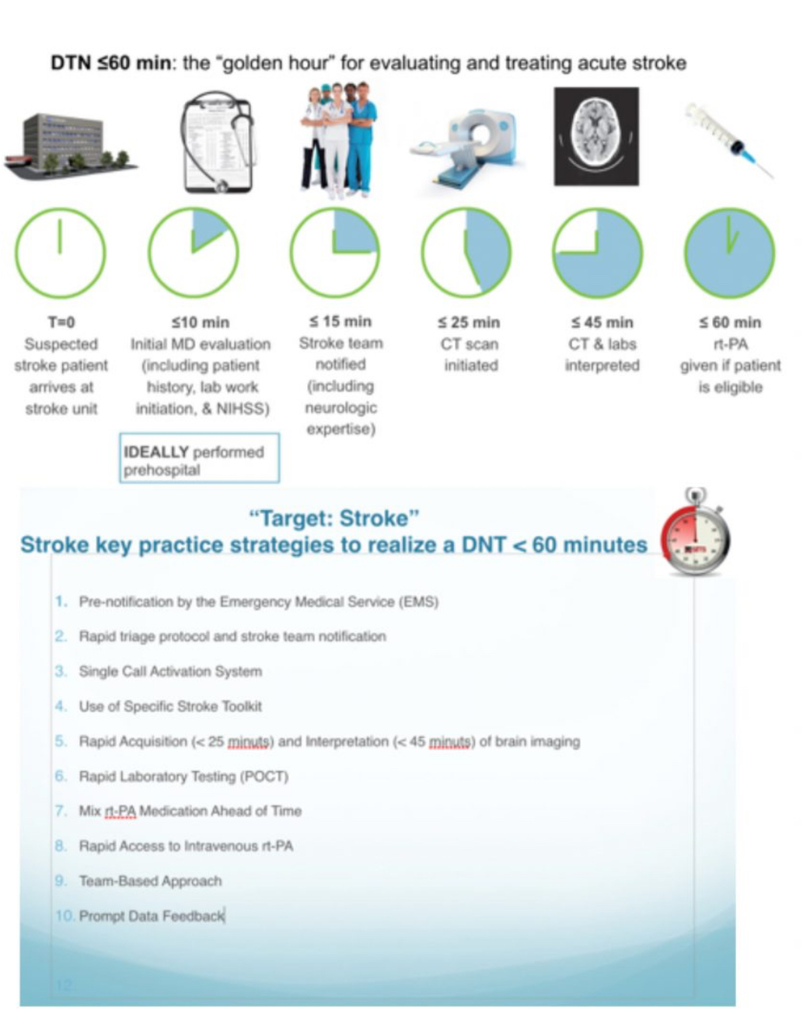
Initial Evaluation in the Emergency Department (ED)
Rapid Triage and Stroke code Activation. Upon arrival, patients should be triaged quickly to minimize delays. The stroke team should be activated immediately. Initial assessment includes the ABCDE approach with stabilizing the patient first, followed by RBS checking.

Slide 12

Neurological Assessment
NIH Stroke Scale (NIHSS)
Developed by Brott and colleagues in Cincinnati (1989) and used as the primary scale of the NINDS rt-PA trial (1995). Lyden and colleagues later standardised training and published the shorter modified NIHSS (2001).
Scoring
Total scores range from 0 (no deficit) to 42 (most severe). In 2026 the decision to thrombolyse rests on whether the deficit is disabling — not on a cut-off score.

Slide 13
Is Creatinine Level Essential Before CT Angiography in Hyperacute Stroke?
Guidelines
Key Findings
- American College of Radiology (ACR): Recommends assessing renal function before contrast administration, especially in patients with risk factors for CIN.
- European Society of Cardiology (ESC): Emphasizes assessing renal function before procedures involving contrast media.
- Low incidence (2.9%) of CIN in acute stroke patients without prior renal dysfunction; no cases required dialysis or progressed to renal failure.
- Many patients with acute stroke can proceed to CT angiography without prior creatinine levels if they have no known renal impairment.
- Higher risk for CIN in patients with chronic kidney disease or diabetes mellitus. Creatinine levels should be assessed prior to contrast administration.
Additional Considerations
Conclusion
Renal impaired (RI) patients have higher risks for reperfusion injury and intracerebral hemorrhage. Communication must be established and documented in patients with known RI, and efforts made to improve renal function in unknown cases before proceeding with time-sensitive treatment.
- AHA/ASA 2026 (Class 1): in suspected LVO, contrast CTA and/or CTP should not be delayed to obtain serum creatinine.
- Check creatinine afterwards; flag known CKD to the team and hydrate.

Slide 14
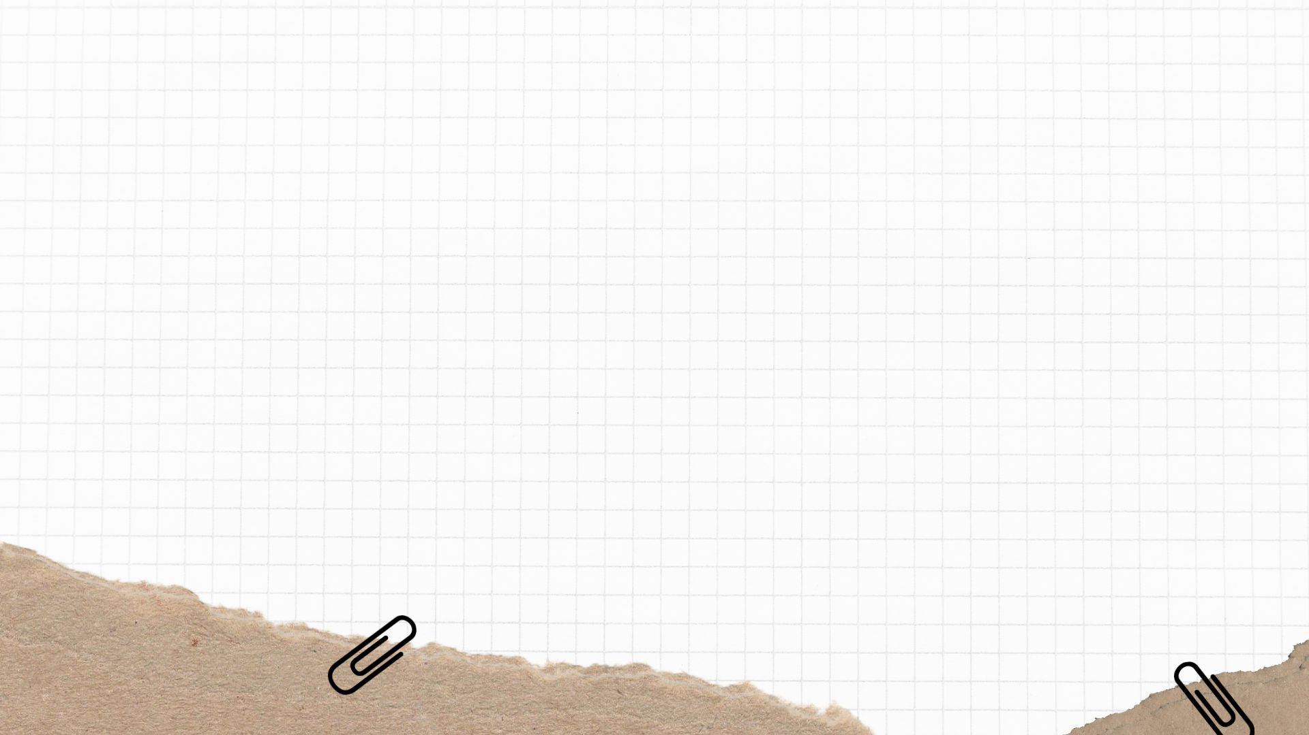
Neuroimaging Protocol
Non-Contrast CT Head
CT Angiography (CTA)
MRI & Perfusion
First test: rules out haemorrhage and shows early ischaemia — dense MCA sign, dot sign, insular ribbon sign, basal ganglia asymmetry, loss of grey–white boundary, cortical hypodensity (score with ASPECTS).
Identifies large vessel occlusion (ICA, M1, M2, basilar) and plans thrombectomy. CTA or MRA — both Class 1, LOE A; CTA wins on speed and availability.
DWI is the most sensitive test for acute ischaemia. DWI–FLAIR mismatch selects wake-up strokes; CT or MR perfusion selects the 4.5–9 h window and late thrombectomy. Within 4.5 h, never delay treatment for it.

Slide 15
Historical Overview of Thrombolytic Therapy
Pioneering Research
Early Clinical Use
Modern Developments
- 1933: Tillett and Garner discovered that certain streptococcus strains could dissolve fibrin clots.
- 1955: Tillett reported clinical effectiveness of streptokinase in patients with vascular thrombi.
- 1940s: Macfarlane and Pilling described fibrinolytic potential of human urine, leading to urokinase extraction.
1958: Sussman and Fitch treated 3 patients with intravenous plasmin for acute ischemic stroke but early studies showed increased risk of intracranial hemorrhage and lack of efficacy.
- 1979: Discovery of tissue plasminogen activator (t-PA).
- 1983: Production of recombinant t-PA (rt-PA).
- 1995: NINDS trial — alteplase effective within 3 hours.
- 2008: ECASS III extends the window to 4.5 hours.
- 2026: AHA/ASA — tenecteplase equal to alteplase.

Slide 16
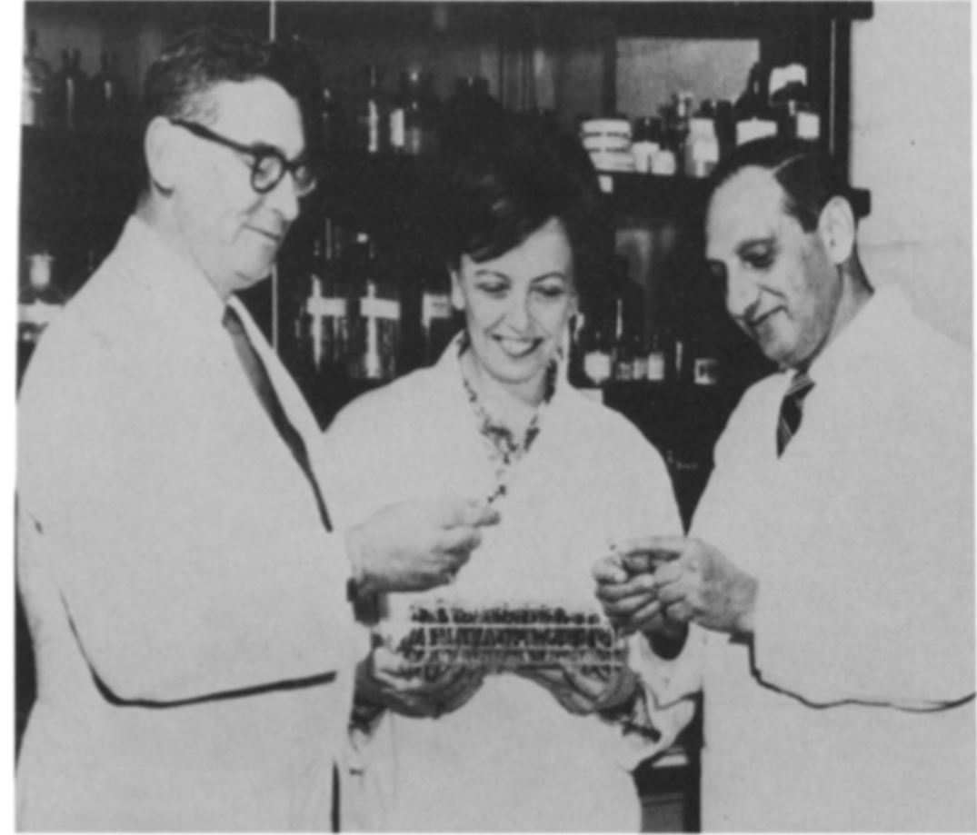
The Innovative Thrombolysis Concept by Tillett and Garner
In 1933, researchers Tillett and Garner made a groundbreaking discovery that would change the course of stroke treatment. They found that certain strains of streptococcus bacteria could dissolve fibrin clots, a crucial step in thrombolysis therapy. This concept opened doors to developing treatments for conditions where blood clots blocked vital arteries. In 1955, Tillett and colleagues gave intravenous streptokinase, derived from these bacteria, to patients for the first time. This pioneering work laid the foundation for future thrombolytic therapies, demonstrating that directly targeting clots could significantly improve patient outcomes in acute situations, ultimately revolutionizing the way we approach stroke care.

Slide 17
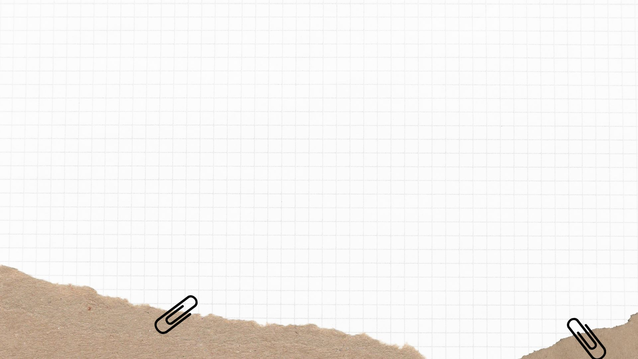
Mechanism of Action of Alteplase
Overview
Steps
Alteplase, or recombinant tissue plasminogen activator (rt-PA), is a thrombolytic agent used to treat acute ischemic stroke by activating the conversion of plasminogen to plasmin, degrading fibrin, and dissolving the thrombus.
1. Alteplase binds to fibrin in the thrombus.
2. This enhances its activation of plasminogen to plasmin.
3. Plasmin degrades the fibrin mesh, dissolving the clot.
4. Alteplase has a higher affinity for fibrin-bound plasminogen, increasing fibrin specificity.

Slide 18
Tenecteplase: tPA Re-engineered
Three mutations of alteplase — T, N and K — give the drug its name
T103N
Adds a glycosylation site → slower clearance
14×
more fibrin-specific than alteplase — less systemic fibrinogen depletion
N117Q
Removes a glycosylation site → less hepatic clearance
~20 min
initial half-life (alteplase < 5 min) — so one bolus, no infusion
KHRR → AAAA
At 296–299 → about 80× more resistant to PAI-1
5 s
single IV bolus — easier for drip-and-ship and transfer
Same mechanism as alteplase: binds fibrin and converts plasminogen to plasmin, which breaks down the clot.
Notes:
T103N, N117Q and the KHRR→AAAA substitution. Longer half-life = bolus dosing.

Slide 19
Tenecteplase in Practice
Dose, evidence and the one mistake to avoid
0.25 mg/kg
single IV bolus over 5 seconds · maximum 25 mg
Volume (mL) = weight (kg) ÷ 20
vial 5 mg/mL · never more than 5 mL
Trials against alteplase
Trial | Result
AcT · Lancet 2022 | Non-inferior
TRACE-2 · Lancet 2023 | Non-inferior
ATTEST-2 · Lancet Neurol 2024 | Non-inferior
ORIGINAL · JAMA 2024 | Non-inferior
EXTEND-IA TNK · NEJM 2018 | More reperfusion before thrombectomy (22% vs 10%)
One vial, two doses
The cardiac dose is about 0.5 mg/kg (30–50 mg). Draw up only the stroke dose and discard the rest. TNK 0.4 mg/kg is not recommended (Class 3).
Same contraindications, BP targets and monitoring as alteplase; symptomatic ICH rates similar.
AHA/ASA 2026: TNK 0.25 mg/kg or alteplase 0.9 mg/kg — Class 1, LOE A. ESO 2023: TNK preferred when LVO.
Notes:
Common error: drawing up the cardiac dose. Formula: mL = kg / 20.

Slide 20
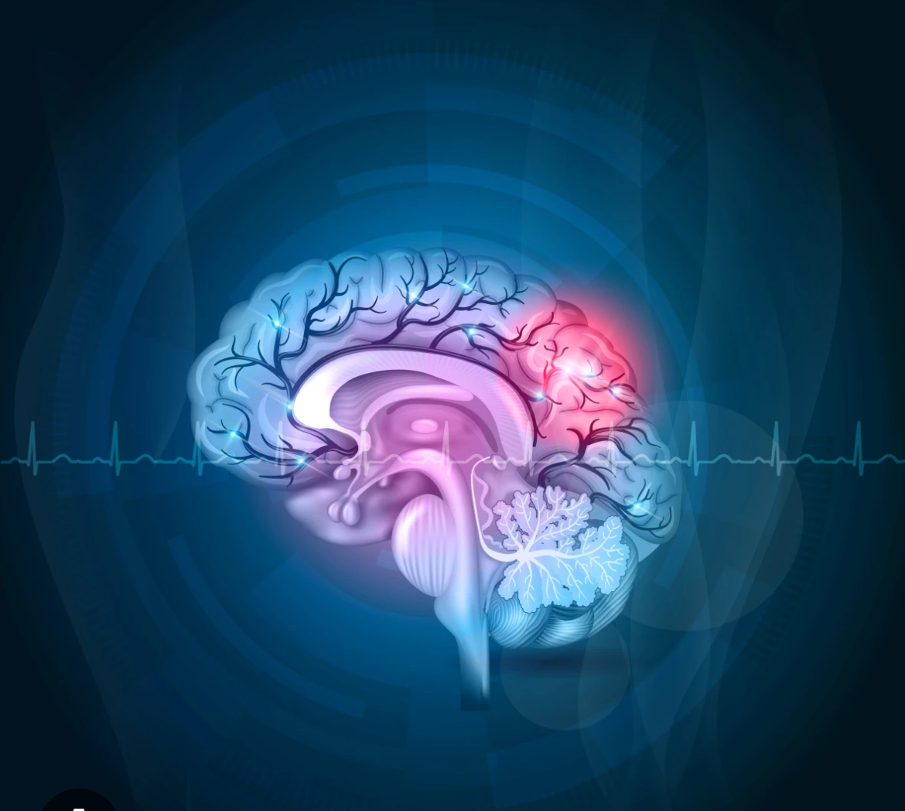

Benefits of Thrombolytic Therapy
Decreased Mortality and Morbidity
Generally decreases mortality and morbidity in stroke patients by dissolving the clot and restoring blood flow.
Therapeutic Window
When given within the therapeutic window, it can reduce long-term disability and improve quality of life.

Slide 21
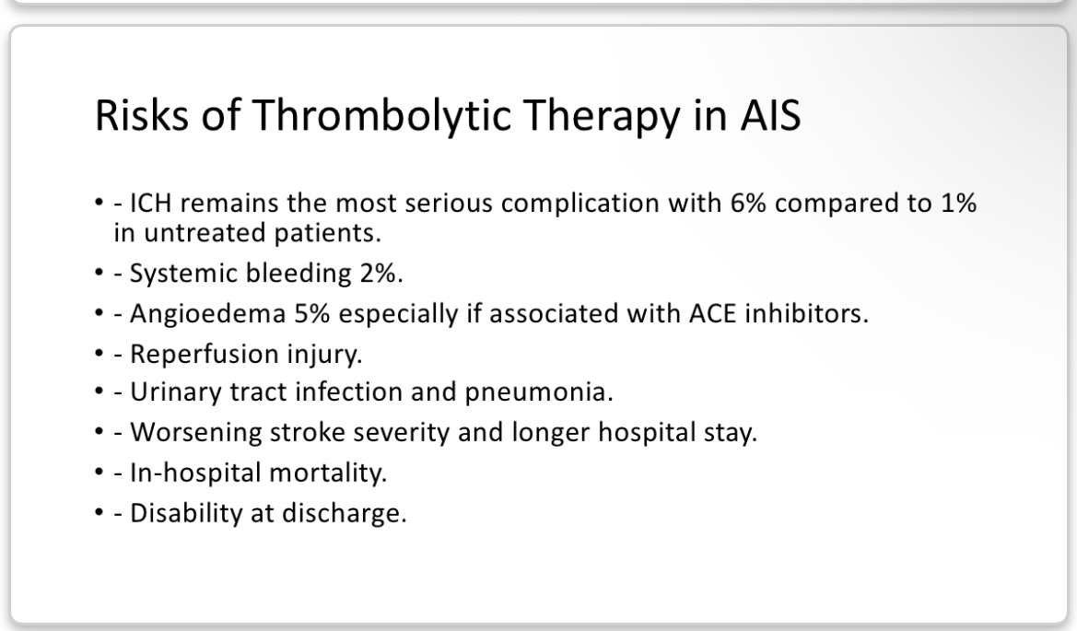
Risks of Thrombolytic Therapy in Acute Ischemic Stroke
Intracerebral Hemorrhage
Symptomatic ICH is the most serious complication: about 6% with alteplase vs 0.6% with placebo in the NINDS trial. Rates with tenecteplase are similar.
Other Complications
Systemic bleeding (2%), Orolingual angioedema (1–5%, more with ACE inhibitors), Reperfusion injury, Urinary tract infection and pneumonia, Worsening stroke severity, longer hospital stay, In-hospital mortality, Disability at discharge.

Slide 22
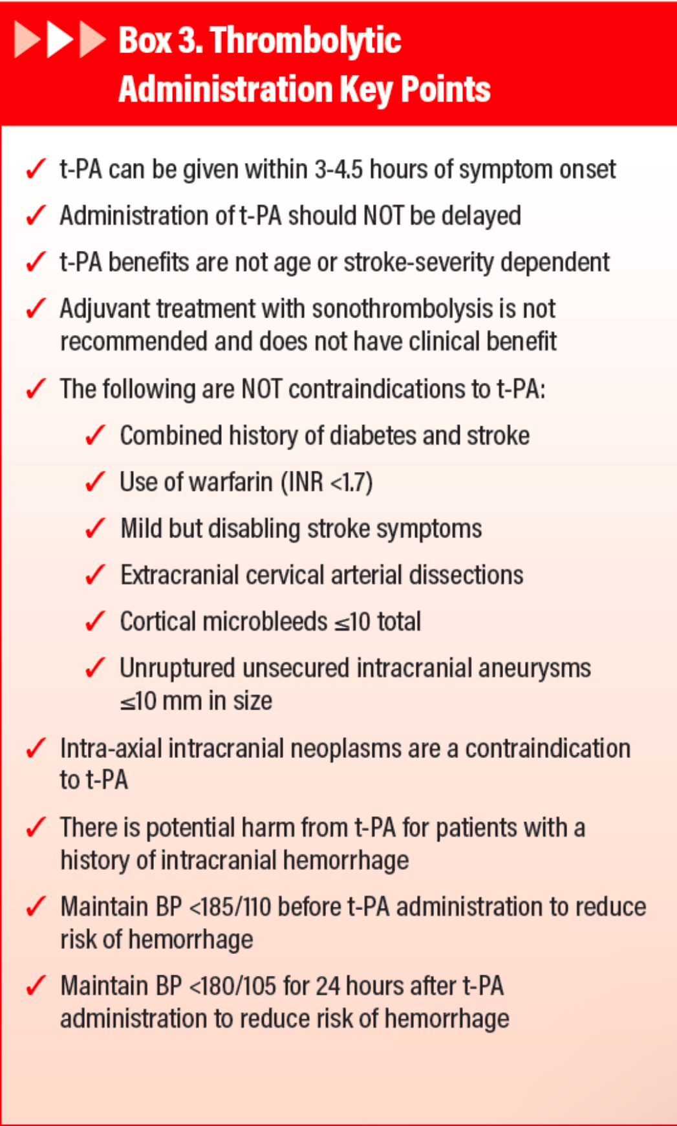

Contraindications to Thrombolysis
Absolute contraindications include prior intracranial hemorrhage, known structural cerebral vascular lesion, known malignant intracranial neoplasm, ischemic stroke within the previous 3 months, recent intracranial or spinal surgery (within 3 months), acute bleeding diathesis, and recent major surgery or serious trauma. Relative contraindications include rapidly improving symptoms, a DOAC within 48 hours (unless drug-specific tests are normal), seizure at onset, recent gastrointestinal or urinary tract hemorrhage, and others. A mild, non-disabling deficit is no longer a 'relative' issue: do not thrombolyse (Class 3).

Slide 23
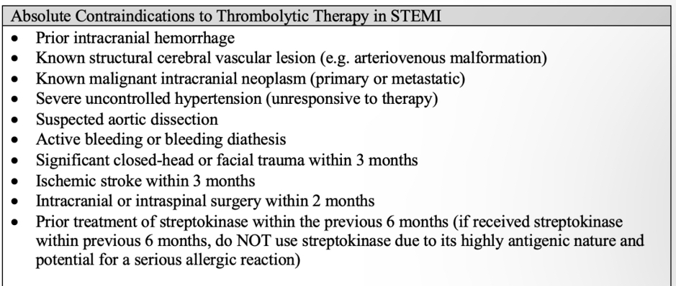
Understanding Absolute Contraindications of Thrombolysis
Thrombolysis is a critical treatment for stroke, but there are some absolute contraindications that prevent its use to ensure patient safety. These include having a history of prior intracranial hemorrhage—imagine if a patient had a previous brain bleed; using thrombolysis could be too risky. Other serious conditions, like known structural brain issues or recent major surgeries, also make thrombolysis inadvisable. For instance, if someone had surgery on their brain within the last three months, thrombolysis should be avoided. Always, patient safety comes first, and understanding these contraindications helps healthcare providers make the best decisions for their patients.

Slide 24
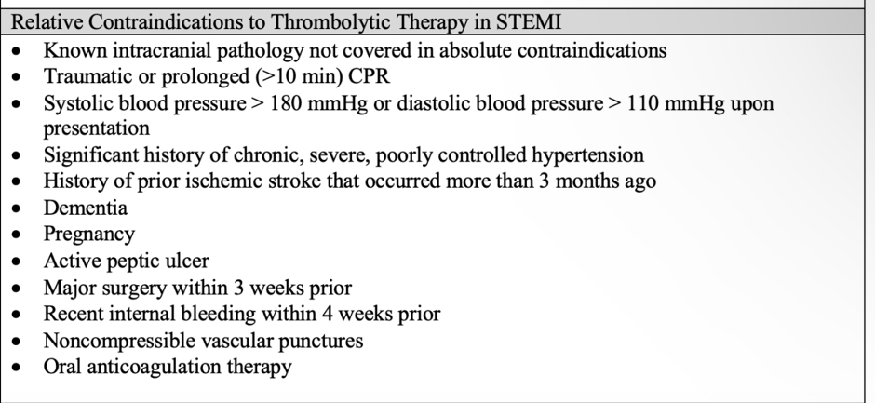
Understanding Relative Contraindications for Thrombolytic Therapy
Relative contraindications for thrombolytic therapy are situations where the risks may outweigh the benefits, but treatment might still be considered under certain conditions. For example, a patient may have a mild stroke with a National Institutes of Health Stroke Scale (NIHSS) score of 4 and a recent gastrointestinal bleed recorded just two weeks ago. In such cases, medical teams might proceed cautiously, weighing the risk of bleeding against the potential benefits of early treatment. Other examples include patients who have had recent major surgery, such as a hip replacement within the last month, or rapid improvement in stroke symptoms. Always, the aim is to ensure patient safety while considering timely interventions.

Slide 25
Dosing in Acute Ischemic Stroke
Alteplase
0.9 mg/kg · max 90 mg
10% as IV bolus over 1 min, then 90% by infusion over 60 min.
Worked example 70 kg → 63 mg: 6.3 mg bolus + 56.7 mg over 60 min
AHA/ASA 2026: Class 1, LOE A
Tenecteplase
0.25 mg/kg · max 25 mg
Single IV bolus over 5 seconds. Volume (mL) = weight ÷ 20, max 5 mL.
Worked example 70 kg → 17.5 mg = 3.5 mL as one bolus
AHA/ASA 2026: Class 1, LOE A
Use actual body weight. Do not exceed the maximum dose. Tenecteplase 0.4 mg/kg is not recommended (Class 3: No Benefit).
Notes:
Both agents are Class 1 within 4.5 h.

Slide 26
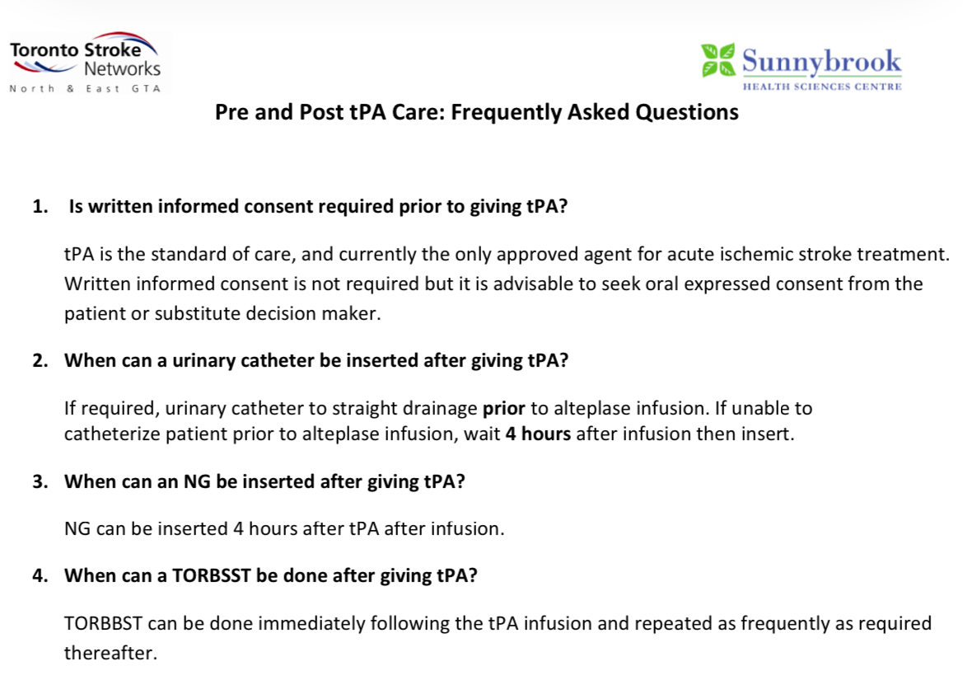
Before Thrombolysing Your Patient, Remember These Steps
Before administering thrombolysis to a patient, several crucial steps must be followed to ensure safety and effectiveness. First, confirm the onset of symptoms—patients presenting within a 4.5-hour window from symptom onset are typically eligible for treatment. Next, ask whether the deficit is disabling — would it stop daily activities or a return to work? The 2026 guideline drops NIHSS cut-offs. Don't forget to review contraindications, like recent major surgery or anticoagulant use. For instance, a patient who had a hip replacement two weeks ago might not qualify. Assessing vital signs and conducting a CT scan to rule out hemorrhage are also essential before moving forward with therapy. Remember, thorough preparation can significantly enhance outcomes!

Slide 27
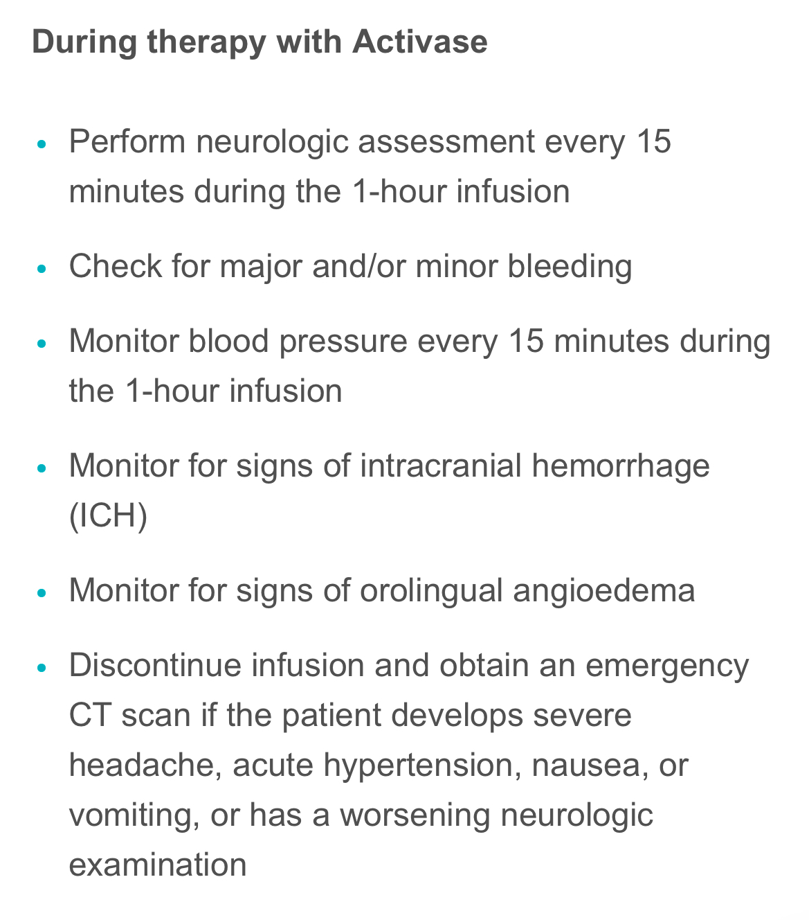
Thrombolysis Administration and Monitoring
During Treatment
Closely monitor for bleeding and neurological status. Keep BP below 180/105 mmHg — but do not push systolic below 140 (Class 3). Avoid invasive procedures. Have cryoprecipitate ready (tranexamic acid as the alternative).
After Treatment
Continue close monitoring for 24 hours. Repeat head CT at 24 hours or if neurological deterioration occurs. Initiate antithrombotic therapy 24 hours after thrombolysis if no intracerebral hemorrhage is present. Consult neurosurgery for large infarcts or edema.

Slide 28
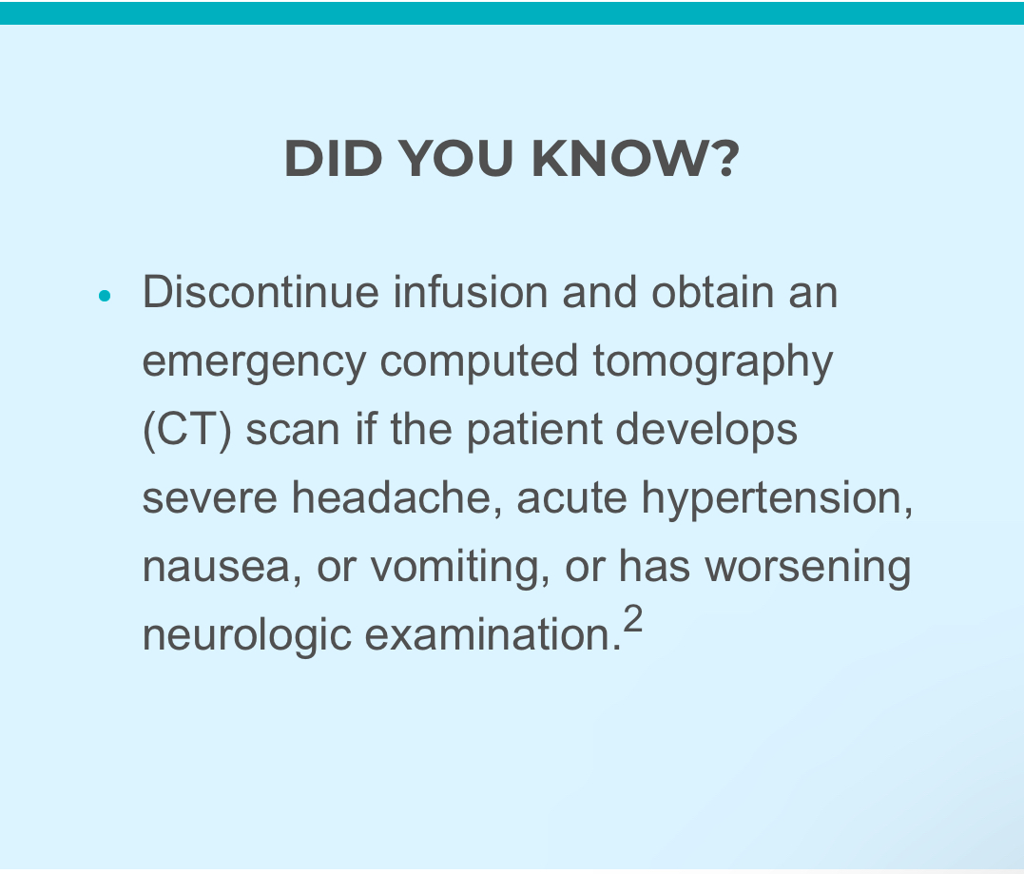
Monitoring During and After Thrombolytic Therapy
Continue to monitor for neurologic deterioration
every 15 minutes for the first hour after cessation of infusion
every 30 minutes for the next 6 hours
every hour from the eighth postinfusion hour until 24 hours after infusion is stopped
Continue to monitor and control blood pressure
every 15 minutes for the first hour after cessation of infusion
every 30 minutes for the next 6 hours
every hour from the eighth postinfusion hour until 24 hours after infusion is stopped
Continue to check for major and/or minor bleeding
Obtain a follow-up CT scan or magnetic resonance imaging (MRI) at 24 hours before starting anticoagulants or antiplatelet agents
Continue to monitor for signs of hypersensitivity

Slide 29
Who Can Benefit from Thrombolysis?
0–4.5 h Disabling deficit, any NIHSS → alteplase or tenecteplase (Class 1). No advanced imaging needed.
Wake-up / unknown onset MRI DWI–FLAIR mismatch, within 4.5 h of recognition (Class 2a).
4.5–9 h, or ≤ 9 h from mid-sleep Salvageable penumbra on automated perfusion imaging (Class 2a).
LVO, 4.5–24 h, no thrombectomy possible Penumbra on perfusion; expert centres (Class 2b).
Not a candidate Mild non-disabling deficit → dual antiplatelets instead (IVT: Class 3, No Benefit).

Slide 30
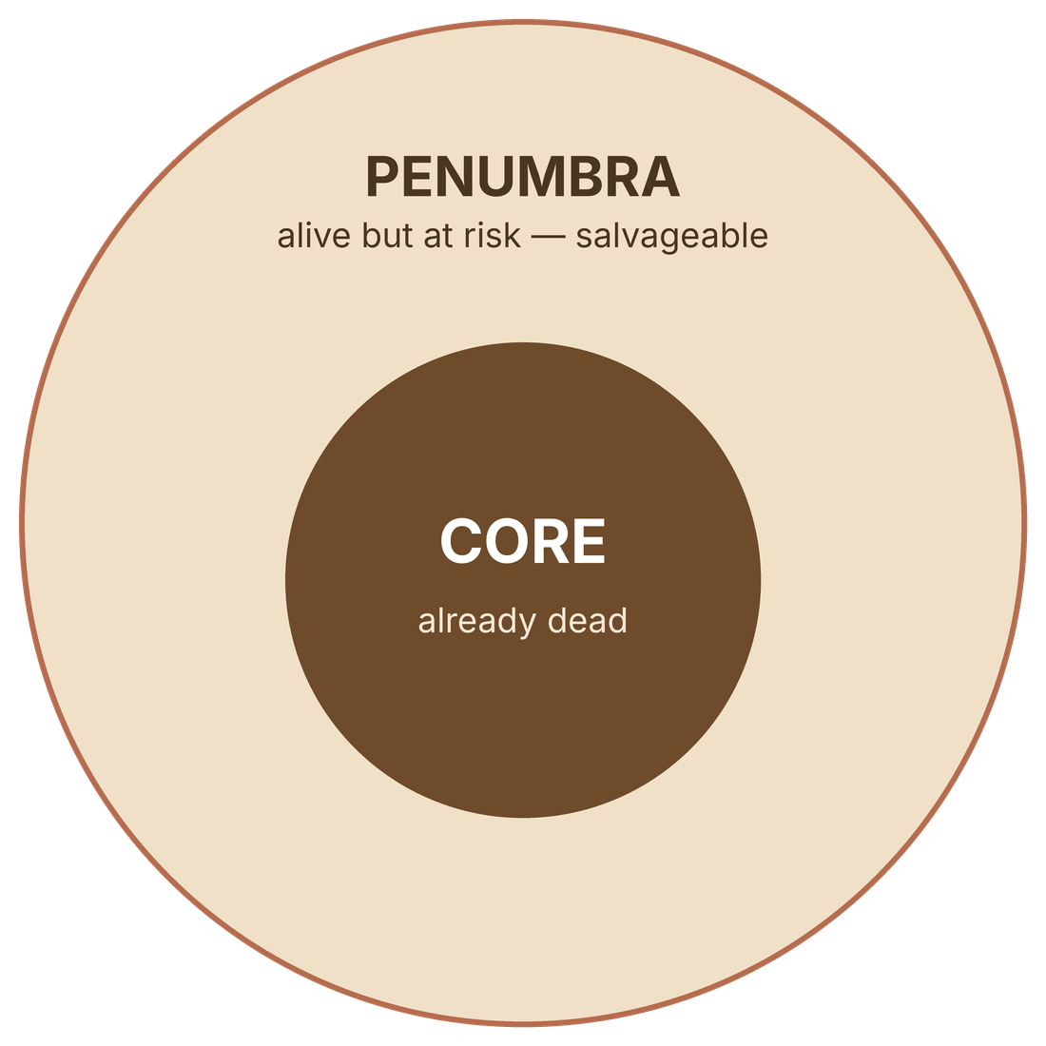
Beyond 4.5 Hours: Is There Penumbra?
After 4.5 h the question is not “how long?” but “what is still alive?”
Automated CTP or MR perfusion
Core < 70 mL · penumbra ≥ 10 mL · mismatch ratio ≥ 1.2 (EXTEND, NEJM 2019)
Wake-up stroke on MRI
DWI lesion < ⅓ of the MCA territory with no marked FLAIR change (WAKE-UP, NEJM 2018)
The price
Symptomatic ICH 6.2% vs 0.9% in EXTEND — why the guideline says Class 2a, not Class 1
AHA/ASA 2026: 4.5–9 h or ≤ 9 h from mid-sleep with penumbra — Class 2a, LOE B-R. ESO 2021: recommended (strong, low-quality evidence).
Notes:
Core = dead. Penumbra = alive but at risk. Perfusion shows the difference; mismatch means there is something to save.

Slide 31
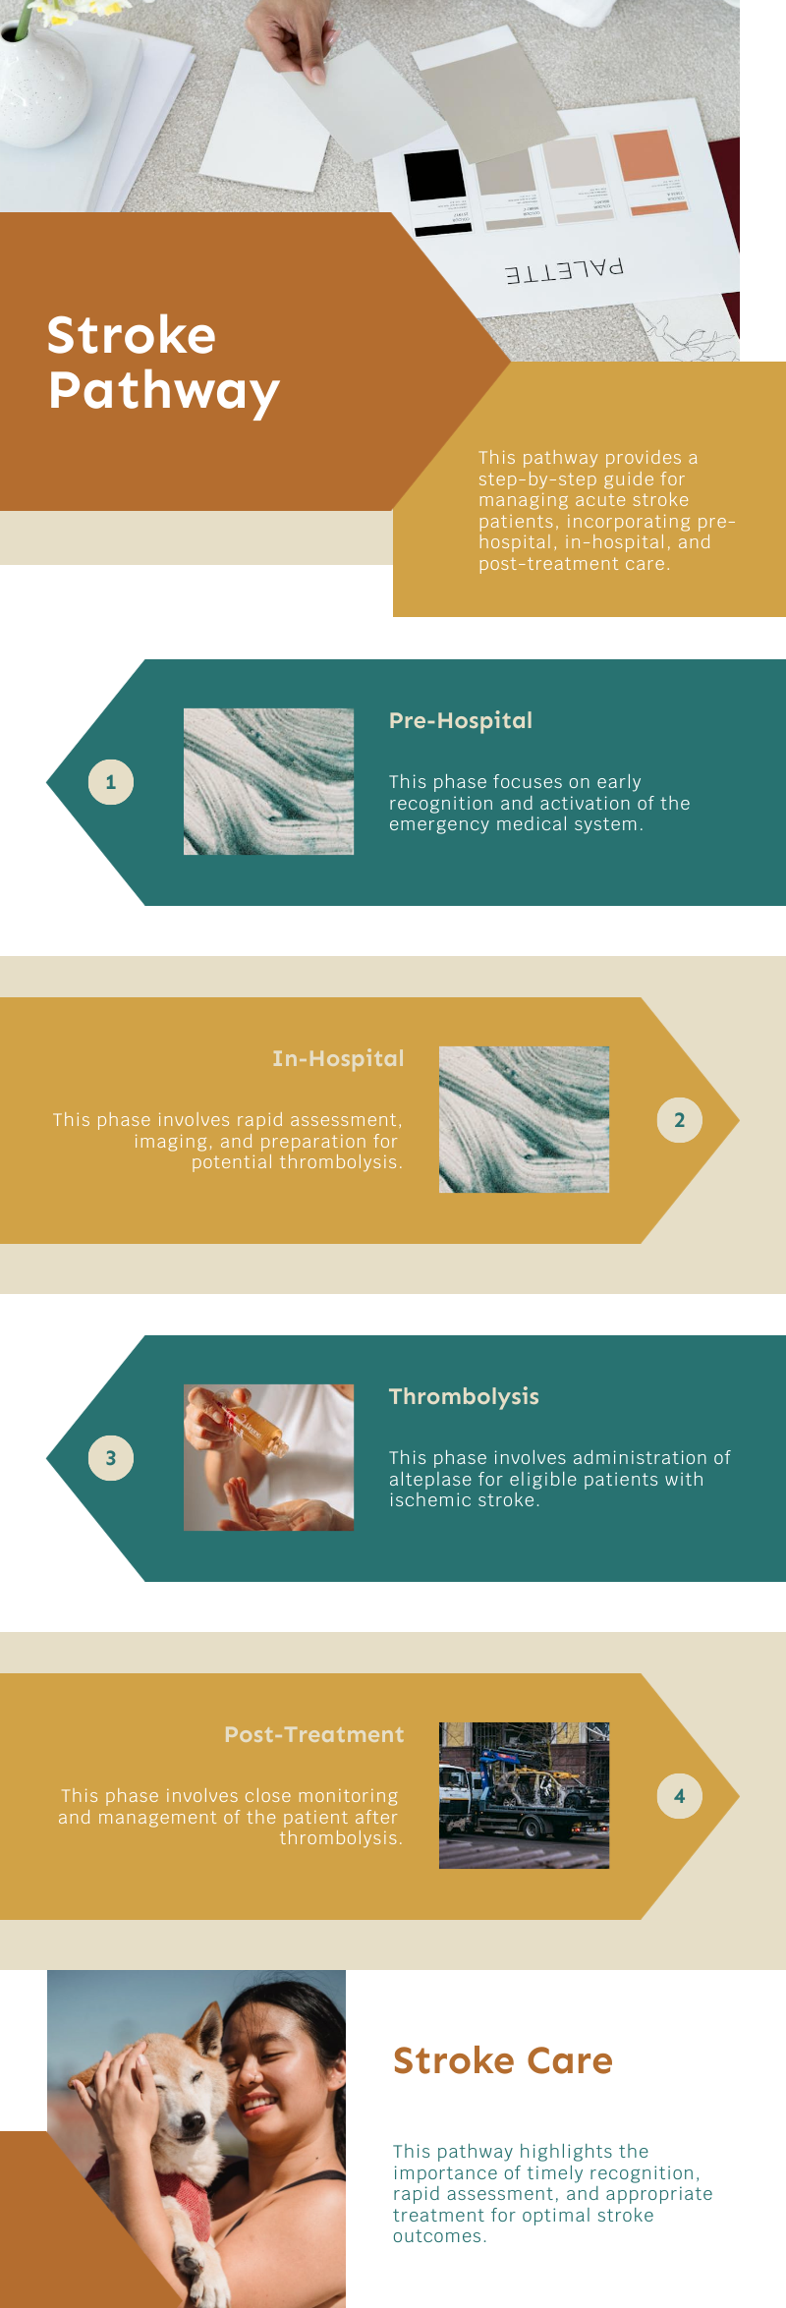
Simplified Steps for Acute Stroke Pathway
1. Pre-hospital
BE-FAST recognition · LVO scale (e.g., RACE) · pre-notify the hospital · mobile stroke unit where available.
2. Hospital arrival
Code Stroke · ABC · glucose · NIHSS · rule out mimics · NCCT + CTA (or MRI/MRA) — don't wait for creatinine.
3. Reperfusion
Disabling deficit ≤ 4.5 h: tenecteplase 0.25 mg/kg bolus or alteplase 0.9 mg/kg, after BP < 185/110. LVO → thrombectomy as well; don't skip IVT.
4. After treatment
HDU/ICU · BP < 180/105 (not < 140) · neuro checks · CT at 24 h before antithrombotics · cryoprecipitate / TXA at hand.
Pathway designed by Dr Mohamed Najm

Slide 32
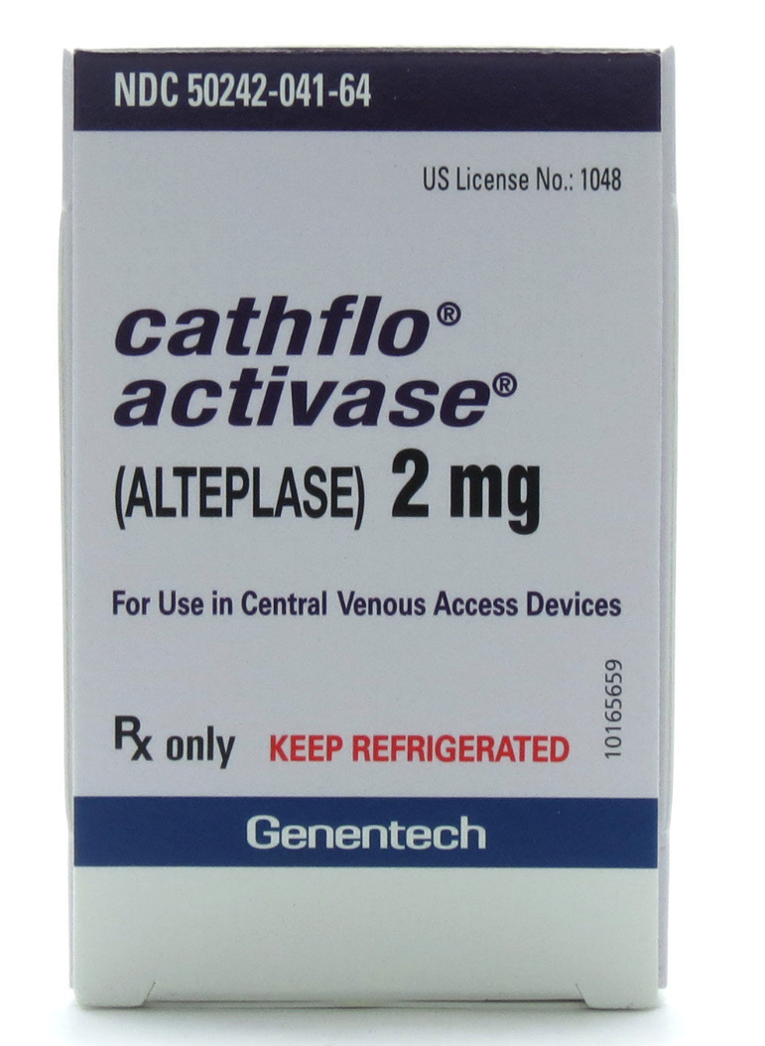
What to Do If Complications from Thrombolysis Occur
Complications from thrombolysis can sometimes arise after stroke treatment. Common issues include intracerebral hemorrhage (ICH) and systemic bleeding. For instance, if a patient develops ICH, they may experience sudden headache or confusion, necessitating immediate imaging to assess the situation. Let's say a patient, originally treated with alteplase, suffers a 5% chance of ICH, which translates to about 1 in 20 patients. It’s crucial that the medical team closely monitors the patient's neurological status and vital signs. If complications occur, timely intervention is key. Treatment may involve supportive care or even surgical options, depending on the severity of the complication, ensuring the best possible outcomes.

Slide 33
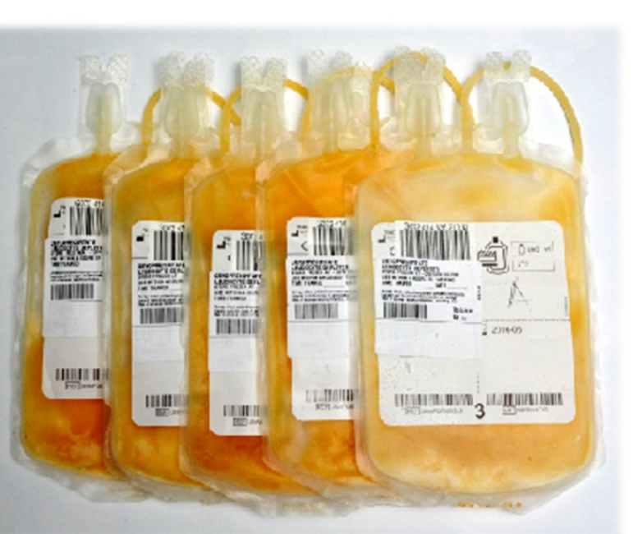
Cryoprecipitate Administration for Thrombolysis-Related Bleeding
Cryoprecipitate is made by thawing fresh frozen plasma at 1–6 °C and collecting the cold-insoluble proteins: fibrinogen, factor VIII, factor XIII and von Willebrand factor.
Indication Bleeding after alteplase or tenecteplase — replaces the fibrinogen they consume.
Dose 10 units (≈ 3–4 g fibrinogen), or about 0.15 units/kg, over 10–30 min.
Target Fibrinogen ≥ 150 mg/dL; recheck and repeat if lower.
Alternative Tranexamic acid 1 g IV over 10 min.
Storage Frozen at ≤ −18 °C for up to 12 months; use within 4 h of thawing.

Slide 34
Advancements in Stroke Management — 2026
Endovascular Thrombectomy (EVT)
Thrombolytic Therapy
Class 1 up to 24 h — now including large cores (ASPECTS 3–5) and basilar occlusion with NIHSS ≥ 10. Medium and distal occlusions: no benefit in ESCAPE-MeVO and DISTAL (2025).
Tenecteplase joins alteplase as Class 1. Imaging-selected thrombolysis up to 9 h (Class 2a).
Telemedicine
Rehabilitation
Telestroke for remote decisions; mobile stroke units are now Class 1.
AHA/ASA 2026 rehabilitation guideline: gradual early mobilisation, no very intense exertion in the first 24 h, task-specific training.

Slide 35
AHA vs ESO: Thrombolysis
AHA/ASA 2026: Class + level of evidence · ESO: GRADE — strong/weak + quality of evidence
Question | AHA/ASA 2026 | ESO | Verdict
Tenecteplase < 4.5 h | 0.25 mg/kg or alteplase — Class 1, LOE A | Alternative to alteplase — strong, moderate quality (2023) | Agree
LVO going to thrombectomy | Either agent; never skip IVT (Class 1) | Tenecteplase preferred over alteplase — strong (2023) | ESO goes further
Tenecteplase 0.4 mg/kg | Class 3: No Benefit | Recommended against — strong (2023) | Agree
4.5–9 h, perfusion mismatch | May be reasonable — Class 2a, B-R | Recommended — strong, low quality (2021) | ESO stronger
Wake-up, DWI–FLAIR mismatch | Class 2a, B-R | Recommended — strong, high quality (2021) | ESO stronger
Mild non-disabling deficit | No IVT (Class 3); DAPT if NIHSS ≤ 5, up to 72 h | No IVT (2021); DAPT if NIHSS ≤ 3, within 24 h (2021) | Agree — AHA wider DAPT
ESO: Berge 2021 (IVT), Alamowitch 2023 (tenecteplase), Dawson 2021 (DAPT). AHA: Prabhakaran 2026.
Notes:
Same direction on almost everything. ESO grades the extended window more strongly; AHA allows DAPT for NIHSS 4–5 and up to 72 h.

Slide 36
AHA vs ESO: Thrombectomy & Blood Pressure
Where the American guideline has moved ahead, and where both agree
Question | AHA/ASA 2026 | ESO | Verdict
Large core, ASPECTS 3–5 | Class 1 at 0–24 h (6–24 h: age < 80, NIHSS ≥ 6, no mass effect) | ESO–ESMINT 2019 guideline predates the large-core trials | AHA ahead
Basilar artery occlusion | Class 1, LOE A: NIHSS ≥ 10, PC-ASPECTS ≥ 6, ≤ 24 h | Suggested — weak, very low quality; NIHSS ≥ 10 (2024) | Same direction, less certainty
BP before IVT | < 185/110 (Class 1) | < 185/110 (2025) | Agree
BP 24 h after IVT or EVT | < 180/105 | < 180/105 (2025) | Agree
SBP < 140 after successful EVT | Class 3: Harm (first 72 h) | Recommended against — high certainty (2025) | Agree
ESO: ESO–ESMINT 2019 (thrombectomy), ESO–ESMINT 2024 (basilar), ESO 2025 BP update. AHA: Prabhakaran 2026.
Notes:
BP is where the two agree most: don't chase low pressures after reperfusion.

Slide 37
Role of AI in Stroke Imaging and Netrin-1 Usage
AI Applications
Deep Learning
AI technologies assist in detecting ischemic and hemorrhagic strokes, improving imaging analysis speed and accuracy.
Convolutional neural networks enhance infarct detection, segmentation, and classification in acute stroke imaging.
Netrin-1
Decision Support
Experimental (preclinical) neuroprotective agent that promotes brain tissue repair and neural regeneration post-stroke by regulating angiogenesis, apoptosis, and neuroinflammation.
AI aids in triage, quantification, and prognostication, helping clinicians make informed decisions quickly.

Slide 38
VR in Rehabilitation and Future Directions
1. Virtual Reality (VR)
Utilized in rehabilitation to create engaging therapy sessions that improve motor function and cognitive skills through immersive environments.
2. Personalized Rehabilitation
VR programs can be tailored to individual needs, enhancing motivation and adherence to therapy.
3. Regulatory Frameworks
Need for clear guidelines to ensure safe AI and VR integration into clinical practice.
4. Bias and Generalizability
Addressing algorithmic bias and ensuring AI systems are applicable across diverse populations.
5. Research Priorities
Focus on prospective clinical trials to validate AI tools and VR in stroke management and ensure their effectiveness and reliability.

Slide 39
SEHA Virtual Hospital [Tele-Stroke] in KSA
Contact Information
Phone number: +966 53 903 8345
Before Calling
- Ensure patient stability.
- Make sure CT and CTA are conducted.
- Calculate NIH score promptly.
Resources
Different guidelines and studies for reference, including AHA Journals, American Stroke Association, National Clinical Guidelines for Stroke, and others.

Slide 40

The Critical Role of Time in Stroke Treatment
Acting swiftly can save lives and reduce disabilities

Slide 41
Pre-Test: The Answers
Q1 · The dose
A
20 mg (4 mL) as a single IV bolus
0.25 mg/kg × 80 kg = 20 mg; at 5 mg/mL that is 4 mL. 40 mg is the cardiac dose; 72 mg is alteplase; 25 mg is only the maximum (≥ 100 kg).
AHA/ASA 2026: tenecteplase 0.25 mg/kg, max 25 mg — Class 1
Q2 · The clock
B
IV thrombolysis
4.5–9 h with salvageable penumbra (core < 70 mL, penumbra ≥ 10 mL, ratio ≥ 1.2) — the EXTEND criteria. No LVO, so no thrombectomy; MRI would only delay treatment.
AHA/ASA 2026: Class 2a · ESO 2021: recommended
Q3 · The mild stroke
C
Aspirin + clopidogrel (dual antiplatelets)
The deficit is not disabling, so thrombolysis adds risk without benefit (PRISMS, ARAMIS). Dual antiplatelets prevent early recurrence. Early full anticoagulation does not help.
AHA/ASA 2026: IVT Class 3 (No Benefit); DAPT recommended
Notes:
Go back over each pre-test question with the audience.

Slide 42
References
1. Prabhakaran S, et al. 2026 Guideline for the Early Management of Patients With Acute Ischemic Stroke (AHA/ASA). Stroke 2026. doi:10.1161/STR.0000000000000513
2. Berge E, et al. ESO guidelines on intravenous thrombolysis for acute ischaemic stroke. Eur Stroke J 2021;6:I–LXII
3. Alamowitch S, et al. ESO expedited recommendation on tenecteplase for acute ischaemic stroke. Eur Stroke J 2023;8:8–54
4. 2025 update to the ESO guideline on blood pressure management in acute ischaemic stroke and ICH. Eur Stroke J 2026;11(5)
5. ESO–ESMINT guideline on acute management of basilar artery occlusion. 2024
6. Richards LG, et al. AHA/ASA 2026 guideline on adult stroke rehabilitation and recovery. Stroke 2026. doi:10.1161/STR.0000000000000536
7. NINDS rt-PA Stroke Study Group. N Engl J Med 1995;333:1581–7 · Hacke W, et al. ECASS III. N Engl J Med 2008;359:1317–29
8. Ma H, et al. EXTEND. N Engl J Med 2019;380:1795–803 · Thomalla G, et al. WAKE-UP. N Engl J Med 2018;379:611–22
9. Menon BK, et al. AcT. Lancet 2022;400:161–9 · Campbell BCV, et al. EXTEND-IA TNK. N Engl J Med 2018;378:1573–82
10. Brott T, et al. Stroke 1989;20:864–70 · Lyden P, et al. Stroke 2001;32:1310–7 (NIHSS)
11. From the original edition: Han et al., J Thromb Thrombolysis 2022 (complications) · Miller et al., J Neurohospitalist 2011 (safety) · Arch Phys Med Rehabil 2023 (robot-assisted therapy) · Tillett & Garner 1933 and history of thrombolysis (Sage) · UpToDate, Stroke Manual and MDCalc (contraindications) · National Clinical Guideline for Stroke (UK)
Notes:
References updated October 2026.

Slide 43

Take This Lecture With You
Scan to download the slides (PDF) to your phone
thetract.org/lectures/stroke-door-to-needle
Updated to the AHA/ASA 2026 guideline, with the ESO comparison, tenecteplase and the extended window.
The Tract · a free, independent neurology library — no ads, no sign-up.
Notes:
QR opens the PDF directly.

Slide 44
Floor Is open for Your Questions and Thoughts

Slide 45
Thank You for Your Attention and Participation

